Slide 1
Variant Calling with GATK
Compiled notes from
Mohammed Khalfan and
Jonathan Flowers

Slide 2

What is Variant Calling?
Identifying single nucleotide polymorphisms (SNPs) and small insertions and deletion (indels) from next generation sequencing data.
Plays an important role in scientific discovery.
Conceptually simple:

Slide 3
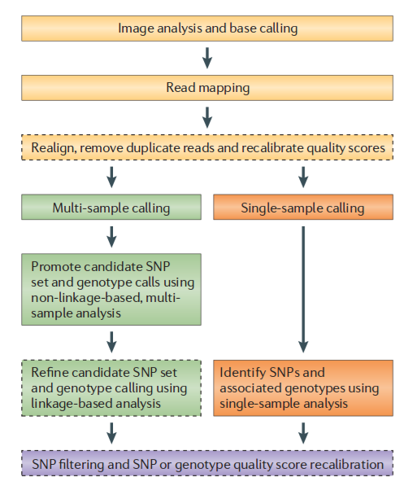
Whole genome resequencing: SNP-calling
Requires assembled genome
Steps to reduce the “false discovery rate” (FDR)
Multi-sample algorithms improve SNP-calling in population studies
Mapped read (UnifiedGenotyepr) and de novo assembly-based (HaplotypeCaller) approaches to multi-sample snp calling
Hard-filtering of suspect SNPs is required in most snp-calling and genotyping applications
Nat Rev Genet . 2011 June ; 12(6): 443–451. doi:10.1038/nrg2986

Slide 4
Genome Analysis Toolkit (GATK)
Developed by the Broad Institute
Industry Standard for identifying SNPs and indels in germline DNA and RNAseq data
In addition to the variant callers themselves, GATK also includes many utilities to perform related tasks such as processing and quality control of high-throughput sequencing data.

Slide 5
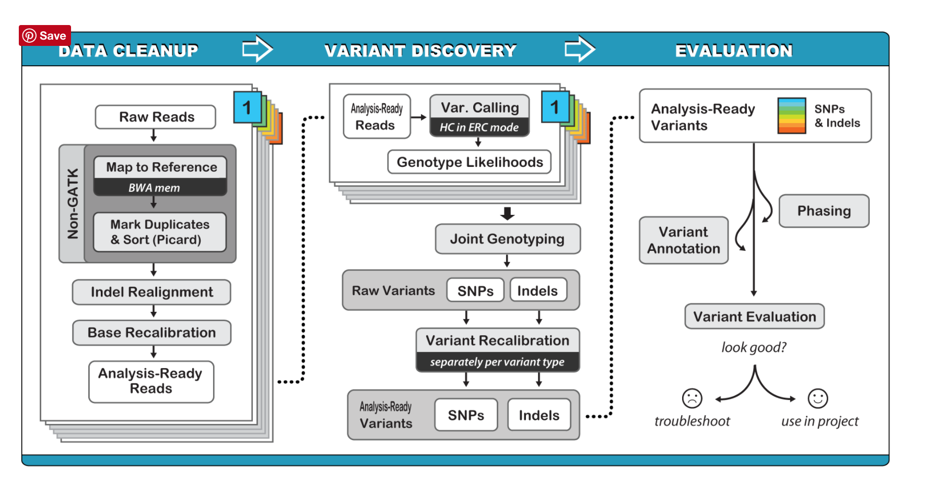
Resequencing work flow (GATK v3.X best practices)**
**With some exceptions for non-human work flows
https://software.broadinstitute.org/gatk/documentation/article?id=3893

Slide 6
Resequencing work flow
Prepare reference genome (e.g., index files)
Process reads
Align reads
Coordinate sort reads
Mark duplicate reads
Re-alignment around insertions/deletions
Base quality recalibration (human data only)
SNP-calling
Variant recalibration (human data only)
Filtering / Quality control

Slide 7
Preparing the reference genome
bwa index (see BWA)
FASTA index (samtools faidx)
GATK index (GATK CreateSequenceDictionary)

Slide 8
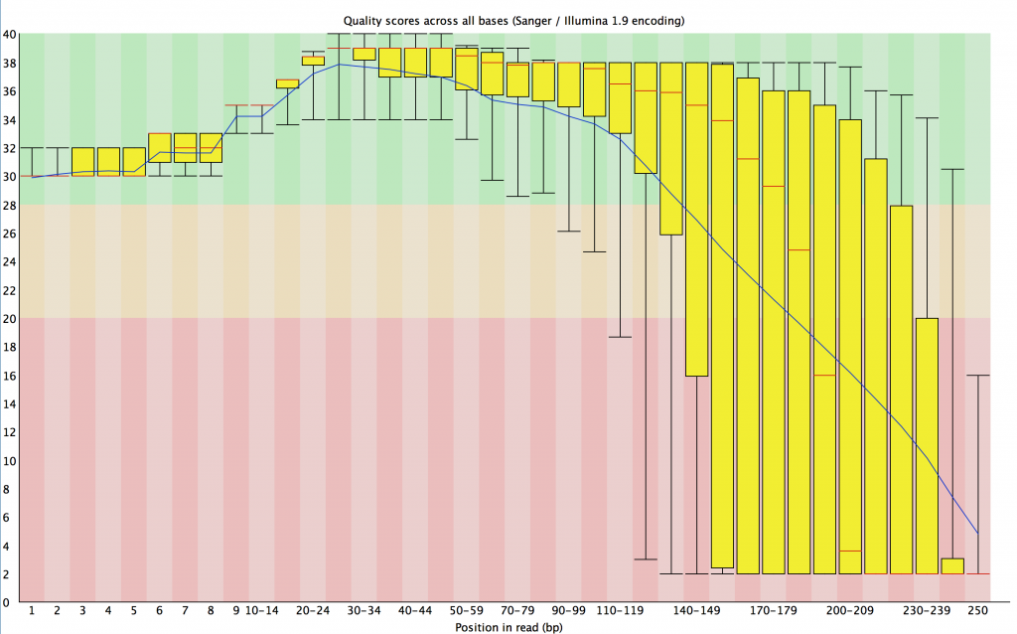
Read quality assessment
Base qualities decay with advancing sequencing cycle in reads generated sequencing-by-synthesis (Illumina)
Errors increase the edit or hamming distance between a read and reference)
Low quality bases (e.g., PHRED < 20) can lead to lower mapping rates or artefacts
Many work flows trim using various sliding window, or fixed length methods
Example:
Trimmomatic sliding window quality filtering + removal of leading/trailing bases below some PHRED QUAL threshold

Slide 9
Adapter cleaning
During library preparation, genomic DNA is fragmented and flanking adapter sequences attached
short read library insert sizes are typically at least 400-600 bp in length (or greater for longer read libraries)
Atypically short inserts can lead to “read through” contamination
Adapters should be removed prior to read-mapping in most applications (esp. de novo assembly)
Removal adapters is technically challenging because of sequencing errors and partial sequences
How? Trimmomatic for Illumina HiSeq data
500 bp
Normal insert sizes
Forward read
Reverse read
Short insert sizes
“read through” adapter contamination

Slide 10
Short read alignment (BWA)
BWA MEM
Recommended for read lengths > 75 bp
  Produces chimaeric alignments
  A “promiscuous” mapper
  Multi-reads are randomly assigned to targets
  Secondary/Supplementary segments from chimaeric alignments (marked in BAM) can be excluded in SNP-calling steps with GATK
  Add read groups with the -R option

Slide 11
Read Groups
Multi-sample/multi-library BAMs are common in resequencing projects
Need means of tracking which sample/library a read came from
Meta-information for each read group stored in @RG header
Each read group must have a unique identifier
Each read is assigned an RG tag with a read group identifier
Example:
@RG Header line (one for each sample/library)
@RG ID:CR2342 PL:Illumina LB:CR2342 DS:/scratch/jmf11/chlamy/fastqs/CR2342/CR2342-1_I07CAGATC_CAGATC_L006_R1_001.fastq.gz_/scratch/jmf11/chlamy/fastqs/CR2342/CR2342-1_I07CAGATC_CAGATC_L006_R2_001.fastq.gz_ SM:CR2342
HWI-ST911:113:C0MK8ACXX:4:2105:4811:106636 163 chromosome_1 4 0 101M = 247 344 … ... X0:i:70 MD:Z:101 RG:Z:CR2342 XG:i:0 AM:i:0 NM:i:0 SM:i:0 XM:i:0 XO:i:0 MQ:i:0 XT:A:R

Slide 12
Coordinate sorting SAM/BAM
BAM alignments may either be unsorted, coordinate-sorted, or sorted on read name (fastq identifier)
Sorting operations are best performed using Picard-tools SortSam
Memory intensive
Creates many temporary files
How do you know if a BAM is coordinate sorted?
Check the BAM header @HD (frequently first line of SAM)
@HD SO:coordinate

Slide 13
Mark Duplicates: Handling PCR duplicates
What is a PCR duplicate?
Not a duplicate
PCR duplicates
Not a duplicate
Reference genome

Slide 14
Mark Duplicates: Handling PCR duplicates
What is a PCR duplicate?
Why are duplicates a problem?
A
A
G
G
G
PCR duplicates can introduce false positive SNP and contribute to genotyping error
PCR error

Slide 15
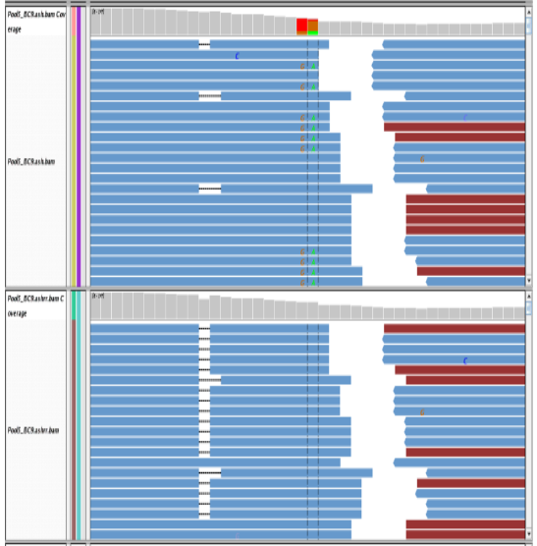
Indel Realignment
Why is it necessary to re-align reads?
Realignment refines insertion-deletion positioning and improves base quality recalibration (and reduction in false positive SNPs in UnifiedGenotyper work flow)
GATK IndelRealignerTargetCreator / IndelRealigner
Before:
After:

Slide 16
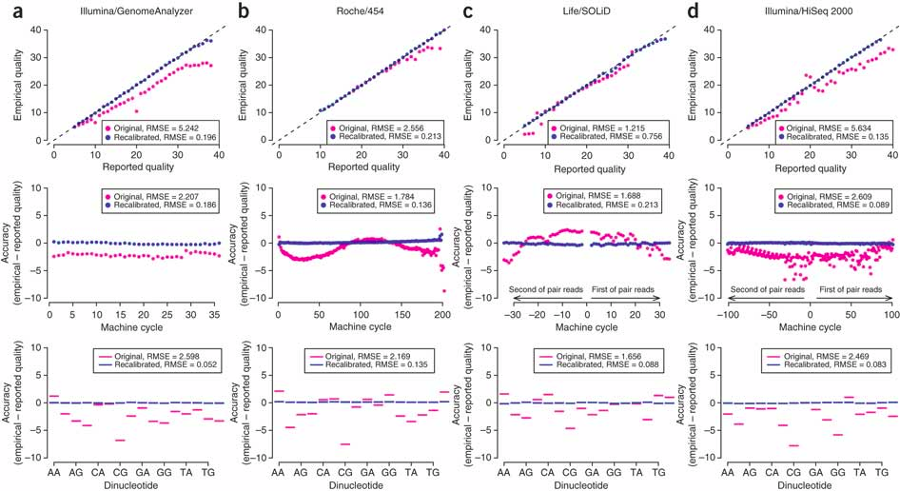
Base Quality Score Recalibration (BQSR)
DePristo et al. (2011)

Slide 17
Base Quality Score Recalibration (BQSR)
Why base quality recalibration?
Base qualities in fastqs are not calibrated (i.e, they are inaccurate)
SNP and Genotype likelihood models use base error probabilities from individual reads to determine SNPs/genotypes
How is recalibration performed?
Recalibration requires large database of high quality SNPs
DePristo et al. (2011)

Slide 18
How are base qualities recalibrated?
Start with dbsnp (NCBI), hapmap or other high quality snp database
For each read in SAM/BAM, identify mismatches with reference
Determine if mismatch in read is in snp database
If mismatch is not in dbsnp, then mismatch is considered an error
Update empirical error rate for sequencing cycle, dinucleotide context etc.
Use empirical estimates of the error rate to build model and adjust base quality scores in SAM/BAM. (Implemented with GATK BaseRecalibrator tool)
Why is this a problem?
Genotype and SNP PHRED qualities are determined by assuming base qualities are accurate

Slide 19
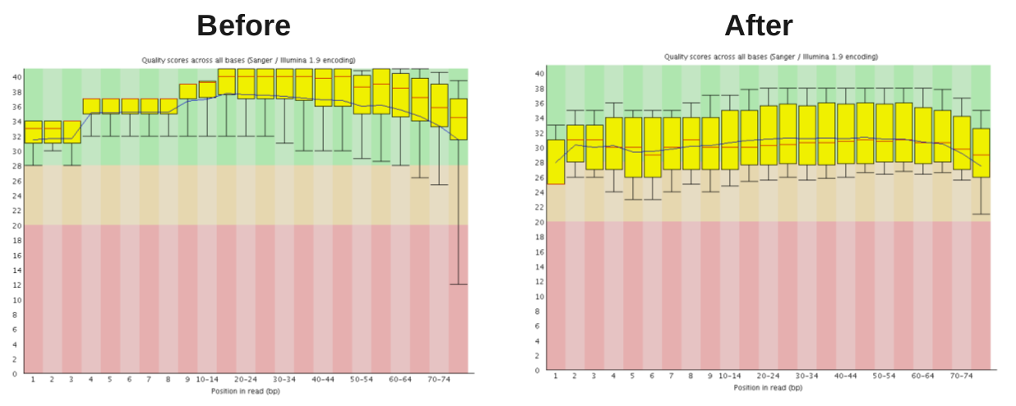
Base qualities before and after BQSR

Slide 20
Variant Quality Score Recalibration (VQSR) (human only)
Why variant quality recalibration?
Errors due to systematic machine artifacts, library prep, SNP-calling, alignment
Uses database of SNPs to train the recalibration model
Allows rigorous assessment of specificity and sensitivity in a call set
Alleviates strong dependence on hard-filtering, eliminates arbitrariness of thresholds
Yields a log odds for each SNP that it is true
DePristo et al. 2011

Slide 21
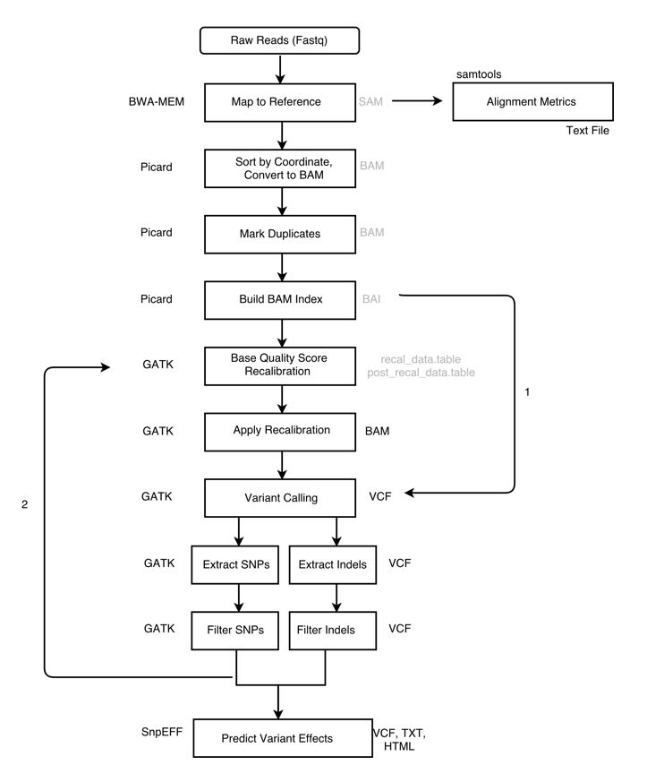
What if you don’t have a set of known variants?

Slide 22
SNP-calling methods
Consensus methods
Example:
1. drop reads with base quality at focal position < Q20
2. if 20% to 80% of Q20+ reads support alternate allele then genotypes is heterozygous otherwise homozygous

Slide 23
Single calling, joint genotyping with the Haplotype Caller
Multi-sample SNP calling (Unified Genotyper, UG) does not scale well.
Invariants sites poorly modeled by UG
UG from poor indel calls and snp-calling errors around indels
UG Suffers from the N+1 problem
https://software.broadinstitute.org/gatk/documentation/article?id=3893

Slide 24
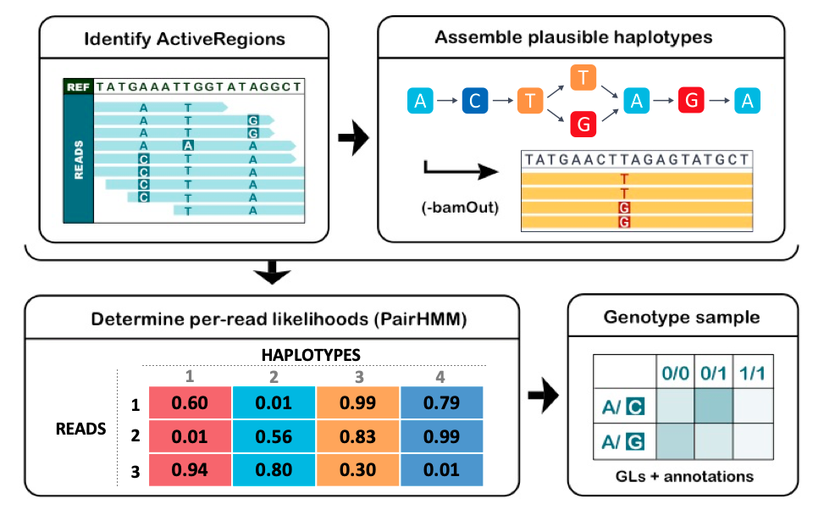
How does the HaplotypeCaller work?
https://gatk.broadinstitute.org/hc/en-us/articles/360035531412?id=11068

Slide 25
How does the HaplotypeCaller work?
Identify “active” regions.
      An active region is defined as an area that contains variation based on sequence alignment.
https://gatk.broadinstitute.org/hc/en-us/articles/360035531412?id=11068

Slide 26
How does the HaplotypeCaller work?
Assemble haplotypes in the active regions.
Assemble the reads to create the different possible haplotypes
https://gatk.broadinstitute.org/hc/en-us/articles/360035531412?id=11068

Slide 27
How does the HaplotypeCaller work?
Determine likelihoods of each haplotype given the reads
Performs a pairwise alignment, using PairHMM, of each read against the different haplotypes to create a matrix that represents the likely of each read to each haplotype.
https://gatk.broadinstitute.org/hc/en-us/articles/360035531412?id=11068

Slide 28
How does the HaplotypeCaller work?
Each variant gets assigned a genotype
Bayes rule is applied to calculate the likelihoods of each genotype based on the likelihood of the alleles
https://gatk.broadinstitute.org/hc/en-us/articles/360035531412?id=11068

Slide 29
How does the HaplotypeCaller work?
https://gatk.broadinstitute.org/hc/en-us/articles/360035531412?id=11068

Slide 30
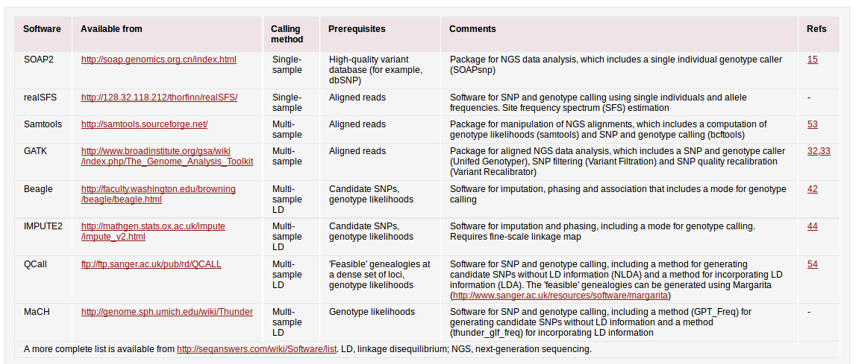
SNP-calling methods
Newer methods include UnifiedGenotyper, HaplotypeCaller, Platypus
Nielsen et al. 2011

Slide 31
Primary sources of error in snp-calling and genotyping
Mutation(s) differentiating paralogs
Errors introduced during library preparation
Base-calling errors
Read mapping errors and biases
a) paralogous regions
b) mis-alignment around indels
c) multiple-mapping
d) mapping bias favoring reference alleles over non-reference alleles
sample
reference
Recent duplication in sample (or deletion in reference)

Slide 32
How to avoid errors in snp-calling and genotyping
Re-alignment around short insertions / deletions
(e.g., GATK IndelRealignmentTargetCreator/IndelRealigner)
Use base alignment quality (BAQ) to cap base qualities at sites close to indel polymorphisms
Ignore multiply-mapped reads during SNP-calling
Filter SNPs in low complexity regions
Filter SNPs with anomalously low or high read depth
Apply filters to remove problematic reads

Slide 33
Filtering protocols adopted in non-human studies
Rice, 15X coverage (Xu et al. 2013)
Type | Filter | Threshold
variant | variant quality | PHRED quality > 20
variant | depth | Covered by > 1 uniquely mapped read in each sample
variant | Hardy-Weinberg | Must be in HWE
genotype | genotype quality | PHRED quality > 20
genotype | Rank sum test | P > .05

Slide 34
Filtering protocols adopted in non-human studies
Plasmodium falciparum >16X (Manske et al. 2012)
Type | Filter | Threshold
variant | coding/noncoding | All non-coding removed
variant | low population frequency | 1% of reads across all samples must contain minor allele
variant | depth | Minor allele must be found at depth > 10 in at least 1 sample
variant | biallelic | SNPs must have 2 alleles only
variant | uniqueness score of flanking bases in ref | SNPs filtered if uniqueness score > 26
variant | missingness | SNPs with fewer than 220 samples at 5X were filtered
variant | hyper-heterozygosity | Population specific cutoffs for variants exceeding HWE-based heterozygosity

Slide 35
Filtering protocols adopted in non-human studies
Sorghum 16-45X (Mace et al. 2013)
Type | Filter | Threshold
variant | variant quality | PHRED quality > 20
variant | SNP clusters | Maximum of 1 SNP per 5 bp*
variant | depth | 100 < depth < 1300
variant | copy number | < 1.5
genotype | genotype quality | PHRED quality > 20
genotype | depth | 4 < depth < 100
genotype | copy number of flanking | < 1.5
genotype | Rank sum test | P > .05

Slide 36
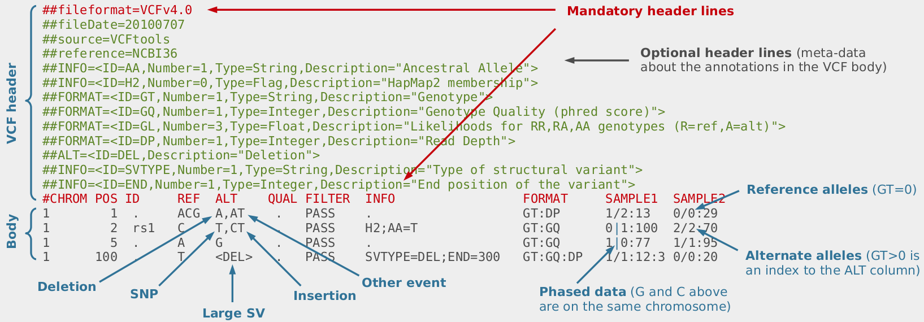
Variant filtering with VCF files
Filter column by default will have “.” (i.e., filters not applied)
Apply filters by adding “tags” to filter column for variants that do not pass the filter
Filters indicate whether values in QUAL or INFO fields meet a specific condition
Can “hard-filter” (ie., remove from the VCF) or rely on downstream tools that that are “filter-aware” (e.g., VCFtools)

Slide 37
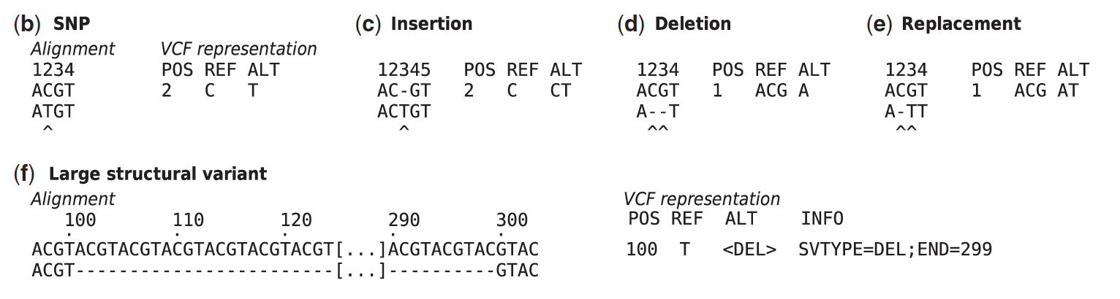
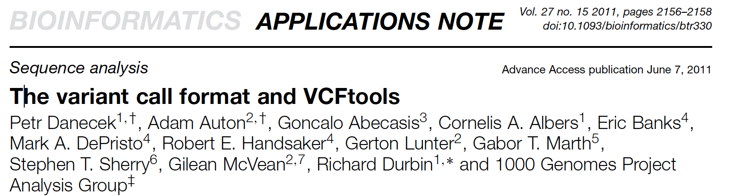
VCF examples

Slide 38
Annotating SnpEff
We use SnpEff
Annotates and predicts the effects of variants on genes
  Codon changes
  Amino acid changes
  Genomic region
  Functional effect (silent, missense)
SnpEff has pre-built databases for thousands of genomes

Slide 39
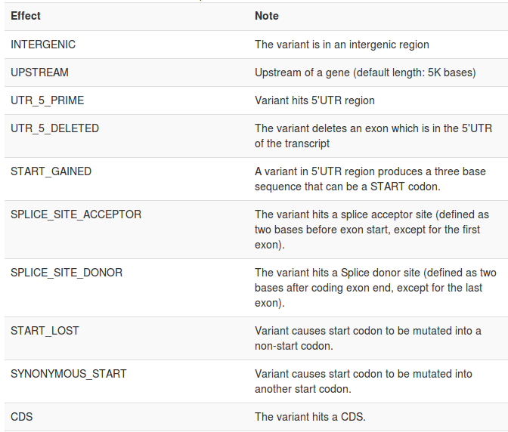
Functional Annotation of SNPs using snpEff
What is snpEff?
Why snpEff?
What type of annotation does
snpEff produce?
SnpEff predictions can
be integrated into VCF for
ease of downstream analysis

Slide 40
The “ANN” tag in VCF: A controlled vocabulary for annotating variants
A new (2015) specification for the ANN tag in the vcf INFO column
Adopts mutation vocabulary from Human Genome Variation Society (HGVS)
http://www.hgvs.org/mutnomen/
VCFannotationformat_v1.0.pdf
Example:
##INFO=<ID=ANN,Number=.,Type=String,Description="Functional annotations: 'Allele | Annotation | Annotation_Impact | Gene_Name | Gene_ID | Feature_Type | Feature_ID | Transcript_BioType | Rank | HGVS.c | HGVS.p | cDNA.pos / cDNA.length | CDS.pos / CDS.length | AA.pos / AA.length | Distance | ERRORS / WARNINGS / INFO'">
AC=34;AF=0.279;AN=122;ANN=C|missense_variant|MODERATE|LOC_Os01g05960|LOC_Os01g05960|transcript|LOC_Os01g05960.1|Coding|1/2|c.40G>C|p.Val14Leu|85/3430|40/3156|14/1051||

